Slide 1
Demographic Analysis of India Tech Ninjas - Abhishek, Arpit, Bhupender and Shishir
The Oxford Dictionary of Economics defines demography as “The study of the characteristics of human populations.”
for our project ,we are showcasing and analyzing some of the pressing demographic aspects like population density and related topics like birth rate and death rate, high density due to industrialization and deforestation. We will also address some of the socio economic issue like illiteracy rate, illegal immigration and mortality rate.

Slide 2
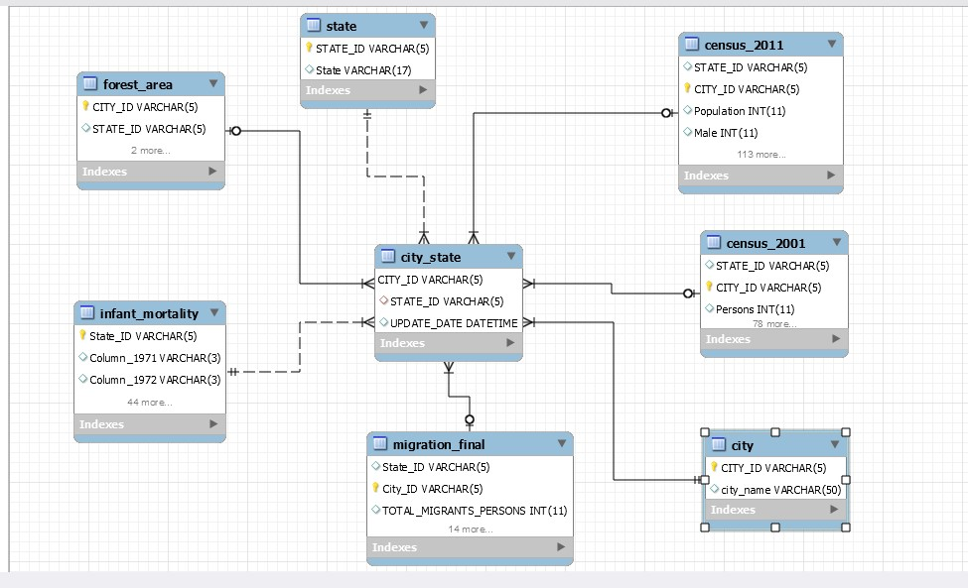
Demographic: Entity Relationship Diagram

Slide 3
Normalization Process
UNF
Base data was downloaded in UNF
1NF
No Repeating groups
2NF
1st Normal Form
All Non key attributes are dependent on all parts of primary key
3NF
Each Field is unique
Data is Atomic
Primary Key
Eliminated Partial Dependencies
1st Normal Form
2nd Normal Form
Eliminated transitive dependencies

Slide 4
Introduction – Business Need
The Purpose of this database is to act as a datamart for the metrics, dimensions and facts related to Demographics of India.
We chose this dataset for few different reasons:
To show population growth over last 20 years and how it has affected forest cover, mortality and gender diversity.
To find out the reason for Population Migration in India
To find out the most populated city for every state and tried to infer which cities can be our next metropolitan city as per development.
To find out Female Literacy growth and how women empowerment and awareness has increased over the years.

Slide 5
Extract – Transform - Load
Data Sources
Census 2001, Census 2011, Forest Cover, Migration, Mortality
Preparation
Removed State names and City names from the base tables
Added primary Keys as City_id and state_id to all the base tables using vlookup and fuzzy lookup algorithm within excel for normalization.
Clean-up
Used OpenRefine, Excel and MySQL to remove spaces and special characters from state and city names
Used Fuzzy lookup to do the Primary key mappings to all the tables.
Transformation
Large Numbers were converted to “M”(millions) and “T” (Thousands)
Percentages were calculated and stored in MySQL views
Loading
We have used MySQl insert statements and SQLizer tool to load data to the base tables.
Lessons
Update statements could only be executed with SQL_Safe_Updates = 0

Slide 6
Create Table & Views Queries

Slide 7
Query1: Top States by Geographical area and Forest Area % #GoGreen
This chart shows area vs forest cover distribution of the top 15 states in India
Northeast states (7 sisters) and UT’s clearly have highest forest covers in India

Slide 8
Query2: States by Population Density #PopulationExplosion
This chart shows population density of states in lakhs and their population per sq kms. Density is shown removing the forest area from the overall land.
This shows that UT’s have high population density.

Slide 9
Query3: Female Literacy growth #Beti Bachao, Beti Padhao
We have compared 2 census data from 2001 and 2011 and could show that how female literacy has grown in those 20 years.
Goa, Dadra&NagarHaveli, Bihar and Jharkhand have increasing trends in terms of female education.

Slide 10
Query4: Migration in India #NRC & CAA
This graph shows states with highest migration counts with reason breakup.
We could infer from this graph that Marriage and Employment are the major reasons people migrate to India.
Maharashtra and UP have registered the highest migrants amongst all the states.

Slide 11
Query5: Infant Mortality #Todays children are tomorrows helmsman
This graph shows states with highest population counts with infant mortality rate per thousand.
We could infer from this graph that population and Infant mortality have no direct correlation.
MP, Orissa have relatively less population than TN and kerala but still have a high infant mortality rate.

Slide 12
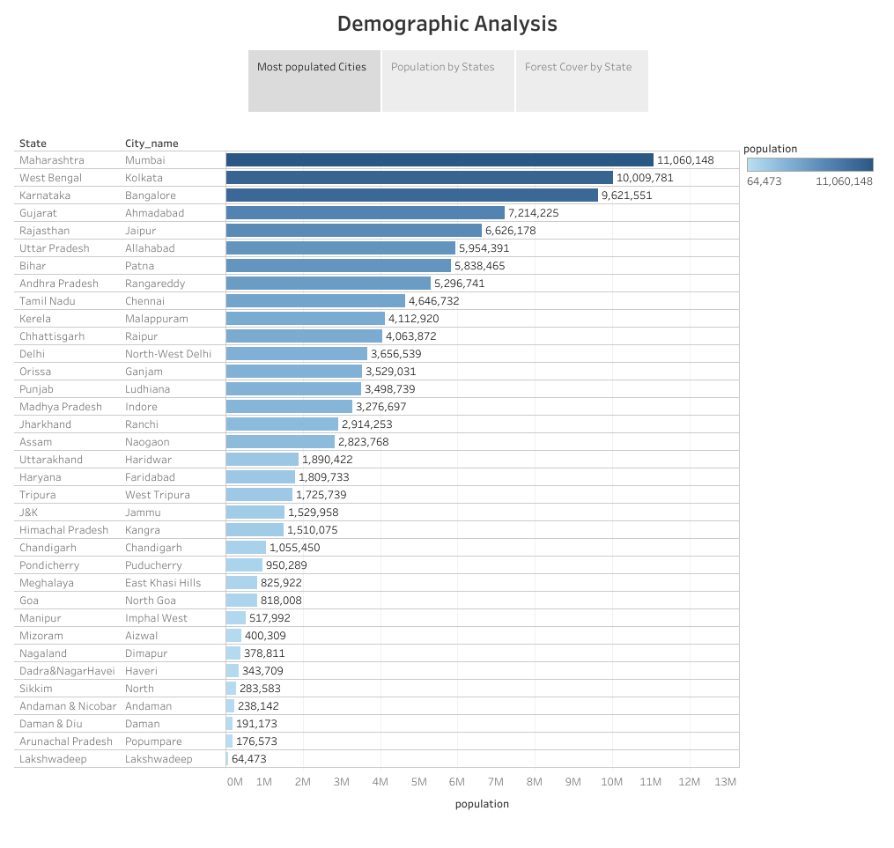
Tableau Integration –
States with their most populated cities

Slide 13
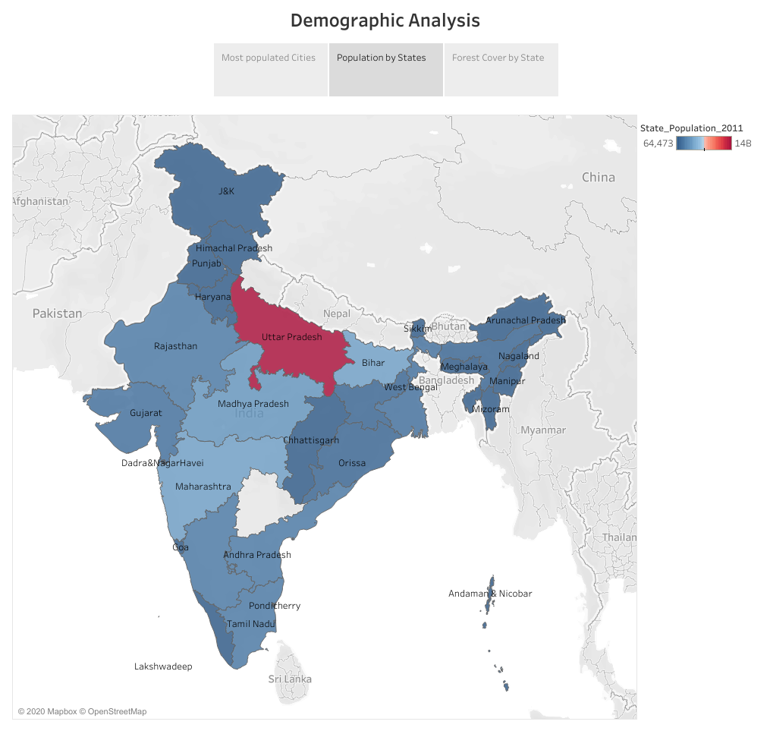
Tableau Integration –
Population by State

Slide 14
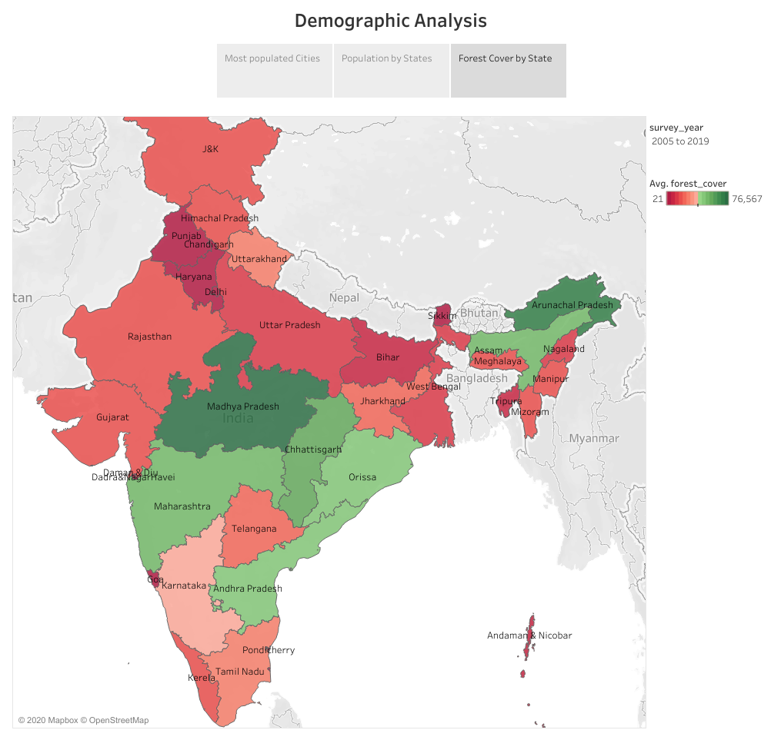
Tableau Integration -
Forest Cover by State

Slide 15
Insights, Corrective measures and recommendations from Data Analysis
North-East states have highest forest covers in India and needs to be preserved with the help of various green initiatives to help reduce carbon footprints.
Delhi, Haryana and Punjab has highest populations and lowest forest covers. More and more tree plantation drives in these states would help reduce pollution as well as improve life expectancy.
Union Territories have higher population densities than other states. Measures can be taken to migrate people to other states by means of creating employment opportunities and livelihood to help reduce population concentration.
Some states like Goa & Bihar has shown steep growth in the female literacy rates. Best practices from these states can be learnt and implemented across other states to help improve this metric across all the states in India
Marriage and Employment are the major reasons people migrate to India. Maharashtra and UP have registered the highest migrants amongst all the states. Measures can be taken to distribute migrants across other states to help reduce population concentration.
Population and Infant mortality have no direct correlation. MP, Orissa have relatively less population than TN and Kerala but still have a high infant mortality rate. Better facilities like vaccinations, healthy and vitamin enrich food can be provided at subsidized rates for infants and expectant mothers in MP & Orissa to help decrease infant mortality rates.
Jaipur, Ahmedabad, Patna, Prayagraj and Bengaluru could be the next metropolitan cities looking at the population density distribution.

Slide 16
Lessons Learned
Data Wrangling – City name, State name standardization across population, migration, forest cover data using open refine and MYSQL
Learnt and used fuzzy lookup method for indexing.
Learnt and applied database normalization
Learnt to create views, tables using complex MYSQL queries with functions like group by, joins, in, where etc
Connected MySQL views to excel reports/dashboards to enable auto-refresh of data.
Learnt and used excel as well as Tableau to visualize data in an intuitive manner.
Learnt to connect excel as a source for tableau and used geo spatial maps in tableau to visualize data for states and cities.

Slide 17

Report Files
Tableau Dashboard

